Slide 1

Welcome to our presentation on the development of the Sports Events Database Project
FITNESS
FITNESS
FITNESS
FITNESS
FITNESS
FITNESS
FITNESS
With Emile Eid and FARId ziade

Slide 2

INTRODUCTION
INTRODUCTION
INTRODUCTION
The Lebanese International University (LIU) in Beirut is gearing up to host a dynamic inter-LIU sports event that spans all its campuses across Lebanon. With the goal of fostering unity among participants from diverse campuses, this event promises an exciting and competitive sports competition. To enhance coordination, the organizing committee is developing a strategic application. This application will efficiently manage reservations for playgrounds and sports equipment, along with coordinating hotel room bookings for participating sport delegations. Beyond sports, this initiative reflects LIU's commitment to cultivating sportsmanship, teamwork, and collaboration within its vibrant campus communities. As LIU prepares for this thrilling sports spectacle, the event not only celebrates athletic prowess but also builds camaraderie among participants from across the university's extensive network.

Slide 3
Logical Order:
DelegationChief: ChiefID (Primary Key), FirstName, LastName, PhoneNumber
Building: BuildingID (Primary Key), Name, Type (Internal or External), Area
Sport: SportID (Primary Key), Name
Equipment: EquipmentID (Primary Key), Type (e.g., Balls, Racket)
LotOfEquipment: LotID (Primary Key), EquipmentID (Foreign Key), BuildingID (Foreign Key), SportID (Foreign Key), NumberofUnits
Reservation: ReservationID (Primary Key), ChiefID (Foreign Key), BuildingID (Foreign Key), SportID (Foreign Key), LotID (Foreign Key, nullable), Date, StartTime, EndTime
Hotel: HotelID (Primary Key), Name, Address
Room: RoomID (Primary Key), HotelID (Foreign Key), Number, Type (Simple or Double), Price

Slide 4
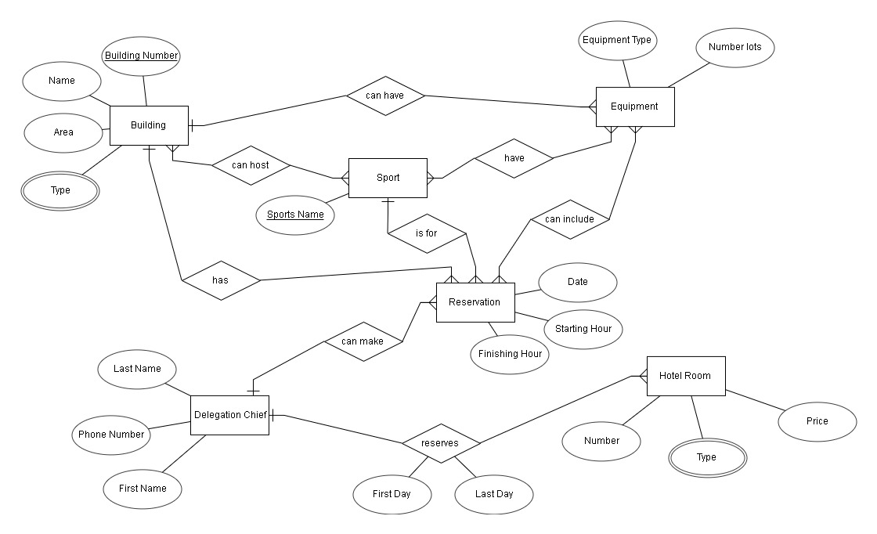
ERD

Slide 5
Mapping
Relational

Slide 6
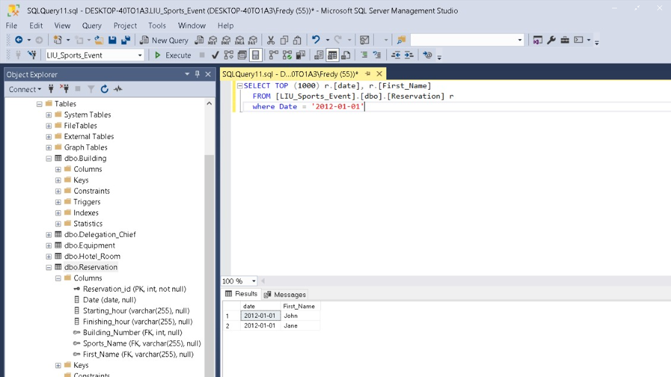
List the name of delegation chiefs who had made reservation for the New Year 2012.
SELECT TOP (1000) r.[date], r.[date], r.First_Name]
FROM [LIU_Sports_Event].[dbo].[Reservation] r
Where Date = ‘2012-01-01’
SQL Queries

Slide 7

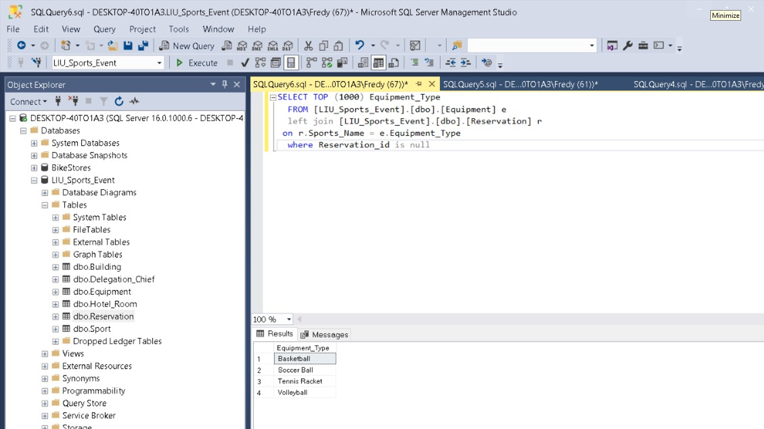
SQL QUERIES
List the equipment(s) that are not yet reserved.

Slide 8
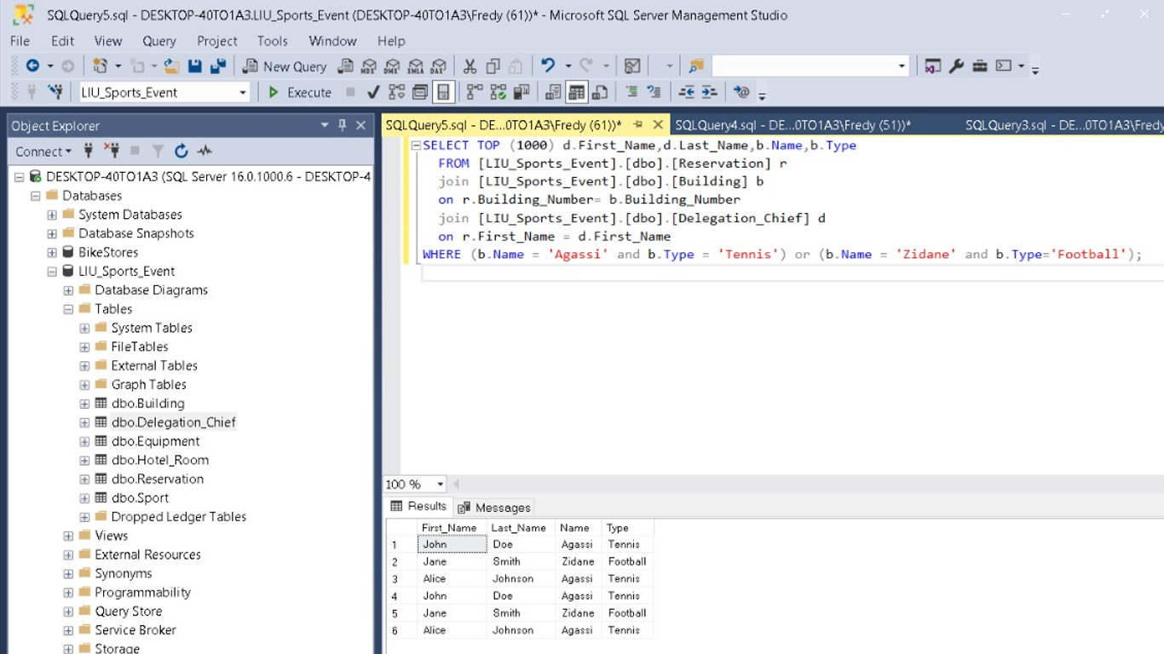
SQL QUERIES
list the name(s) of the delegation chief that had reserved the building “Agassi” for playing tennis and the building “Zidane” for playing football.

Slide 9
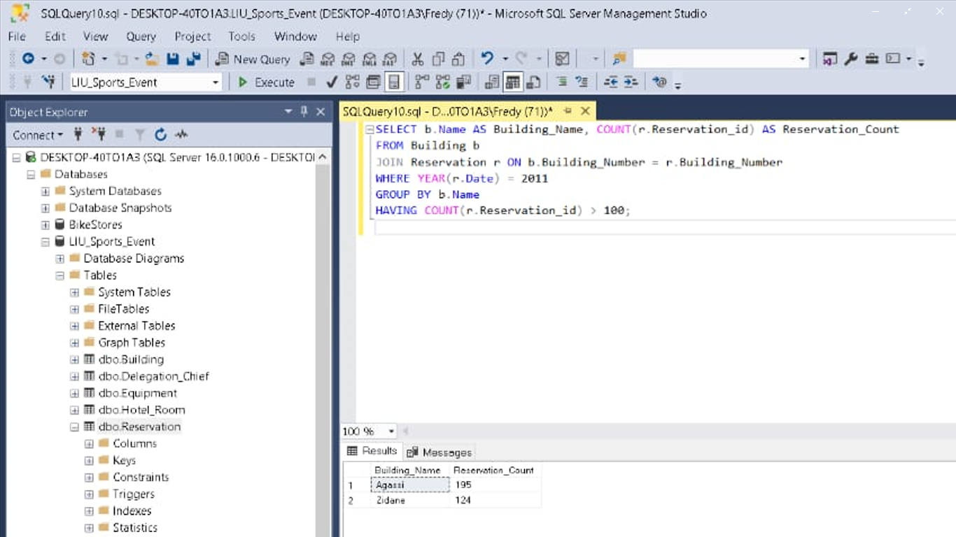
SQL QUERIES
List the name of the building that is reserved more than 100 of times for the year 2011.

Slide 10
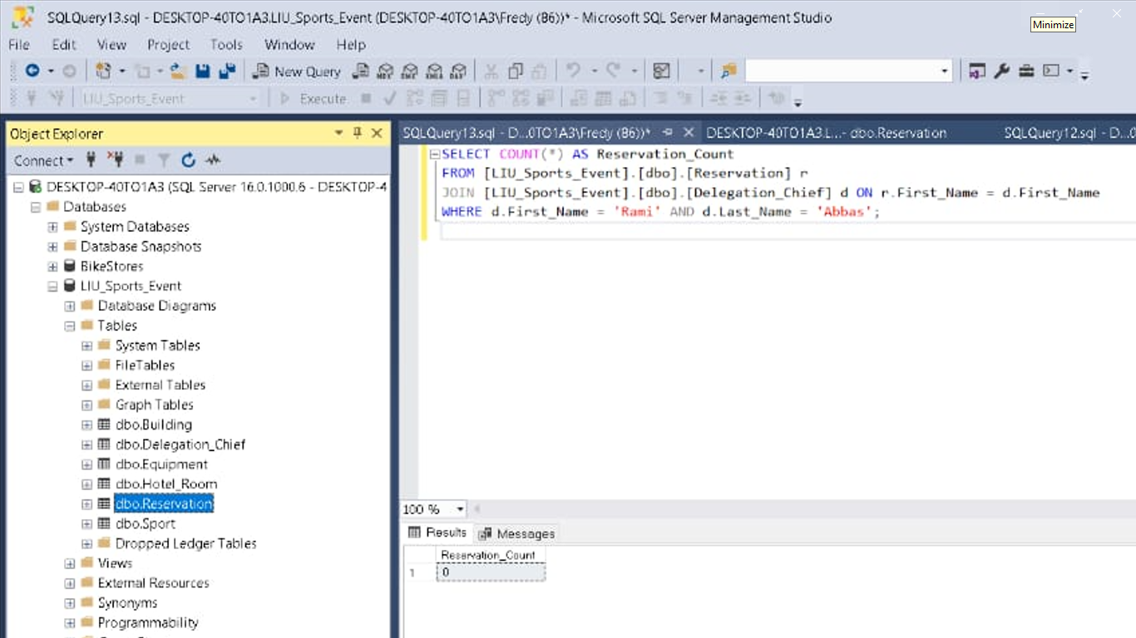
SQL QUERIES
Give the number of reservation done by the delegation chief “Rami Abbas”.

Slide 11
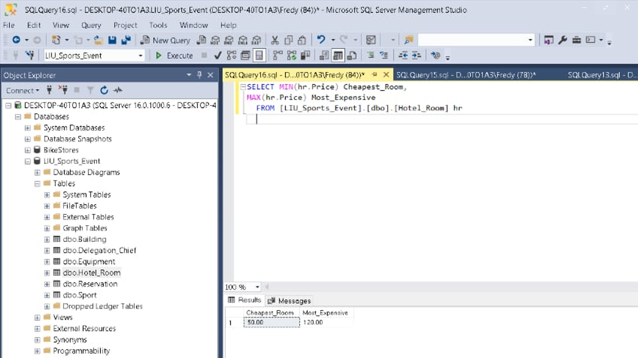
SQL QUERIES
GiVe The MOST EXPENSIVE AND CHEAPEST HOTEL ROOM.

Slide 12
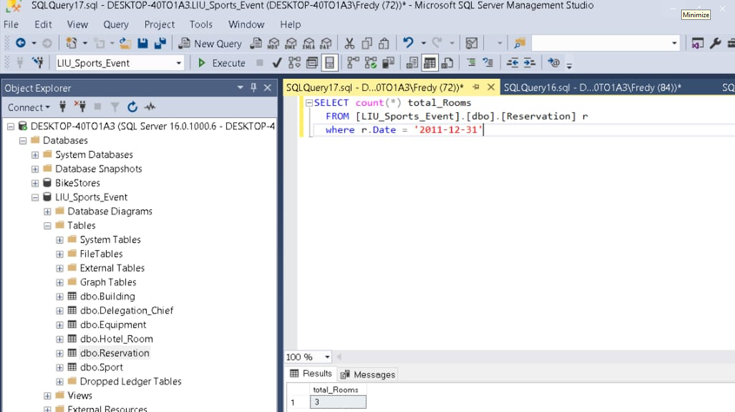
Give the total number of rooms available on 31/12/2011.
SQL QUERIES

Slide 13
All tables are already in 1NF as they have atomic values.
Tables:
DelegationChief: ChiefID (Primary Key), FirstName, LastName, PhoneNumber
Building: BuildingID (Primary Key), Name, Type (Internal or External), Area
Sport: SportID (Primary Key), Name
Equipment: EquipmentID (Primary Key), Type (e.g., Balls, Racket)
LotOfEquipment: LotID (Primary Key), EquipmentID (Foreign Key), BuildingID (Foreign Key), SportID (Foreign Key), NumberofUnits
Reservation: ReservationID (Primary Key), ChiefID (Foreign Key), BuildingID (Foreign Key), SportID (Foreign Key), LotID (Foreign Key, nullable), Date, StartTime, EndTime
Hotel: HotelID (Primary Key), Name, Address
Room: RoomID (Primary Key), HotelID (Foreign Key), Number, Type (Simple or Double), Price
Second Normal Form (2NF):
Second Normal Form (2NF):
Remove partial dependencies.
EquipmentLot: (LotID, EquipmentTypeID, BuildingID, SportID, Units)
Partial dependency on (BuildingID, SportID). Move BuildingID and SportID to a new table.
To New Table:
EquipmentLot (LotID, EquipmentTypeID, Units)
BuildingSportRelation (BuildingID, SportID, LotID
Third Normal Form (3NF)
Remove transitive dependencies.
Reservation: (ReservationID, DelegationChiefID, BuildingID, SportID, LotID, StartDate, EndDate)
Transitive dependency on (BuildingID, SportID). Move BuildingID and SportID to a new table.
New Tables:
. Reservation (ReservationID, DelegationChiefID, LotID, StartDate, EndDate)
. BuildingSportReservation (BuildingID, SportID, ReservationID)

Slide 14

THANK YOU
THANK
YOU
THANK
YOU
THANK
YOU
THANK
Done By:
Emile Eid
Farid Ziade

